Slide 1

Simple Conveyancer – BCC Rates Calculator

Slide 2
Simple Conveyancer – BCC Rates Calculator
The purpose of this application is to create a basic web portal through which a law or conveyancing firm may use their firm username to log in, then be able to use the application to enter their clients’ details regarding an upcoming property sale within the Brisbane City Council area in order to automatically calculate the rates either owing by or owed to the client (sale-side) at time of settlement.
- Client Number (Auto Generated)
- Client Name
- Property Address
- Sale Price
- Deposit Paid
- Settlement Date
- Rates Paid/Payable
- Rates Paid Status

Slide 3
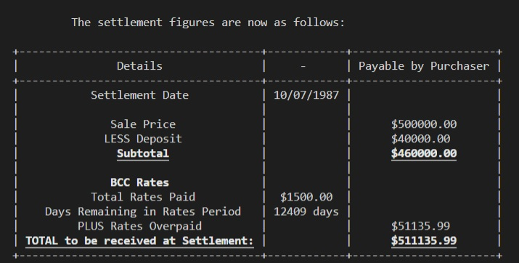
- > Prior Python Application

Slide 4
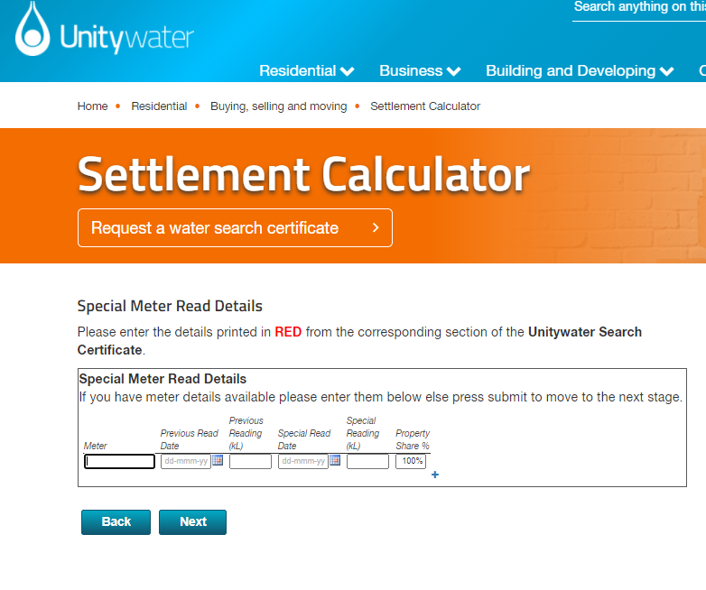
Simple Conveyancer – BCC Rates Calculator - > Unity Example

Slide 5

- > Persona 1 -
Persona 1:
- Fictional Name: David Justice
- Photo: Stock Photo
- Job Title: Conveyancing & Property Lawyer
- Demographics:
-- 30 years old
-- Married
-- Father of two children
- Goals and tasks:
-- David is very efficiency and precision orientated, he has no time for applications or business processes that slow down the conveyancing process or produce errors for his clients. He wants a reliable portal that can be used quickly to calculate the conveyancing settlement figures and have them stored historically.

Slide 6

- > Persona 2 -
Persona 2:
- Fictional Name: Gladys Numbers
- Photo: Stock Photo
- Job Title: Retiree, property investor
- Demographics:
-- 72 years old
-- Married
-- Mother of four children
- Goals and tasks:
-- Gladys is very profit focused and has successfully sold a number of investment properties over the last two decades. She does not always do the conveyancing process herself but does wish to understand the calculations of figures for her own knowledge and to ensure she is not being shortchanged.
-- She wants a reliable portal that can be used quickly to calculate the conveyancing settlement figures and have them stored historically.
-- She spends her time mostly retired but does spend evenings review documents for her investment properties.

Slide 7
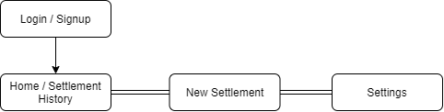
Sitemap

Slide 8
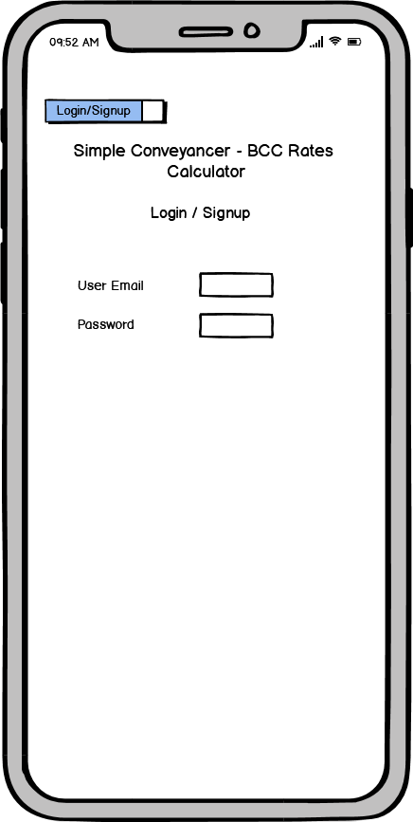
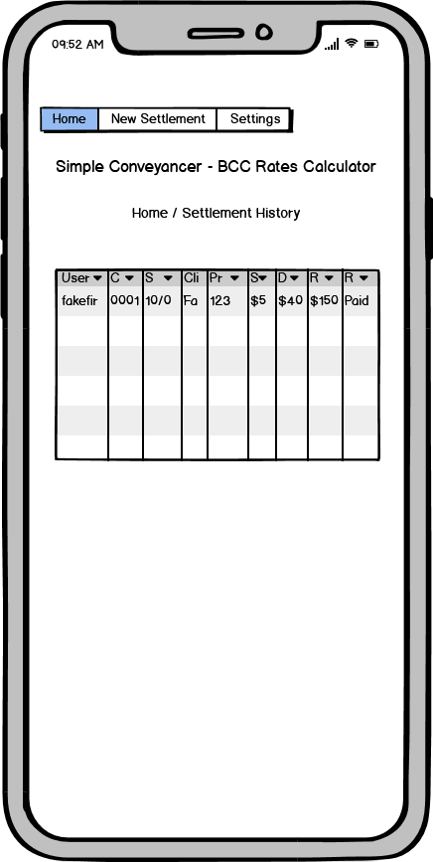
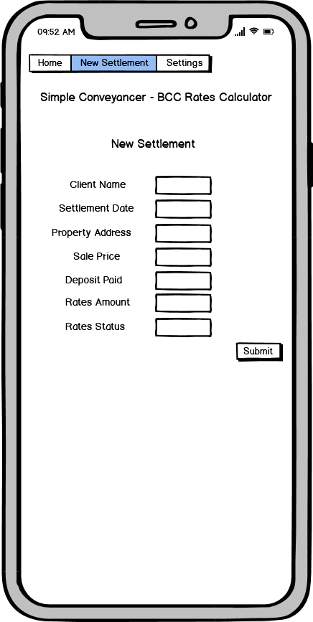
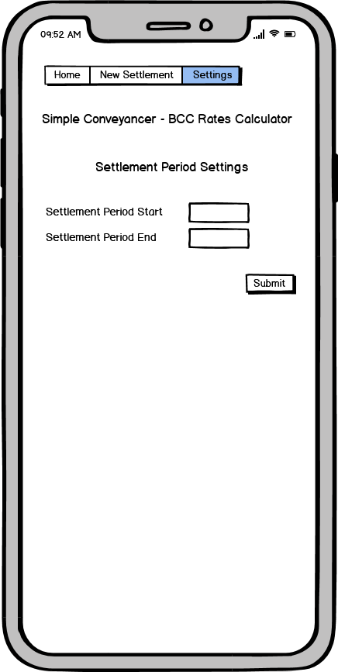
Wire Frames - Mobile

Slide 9
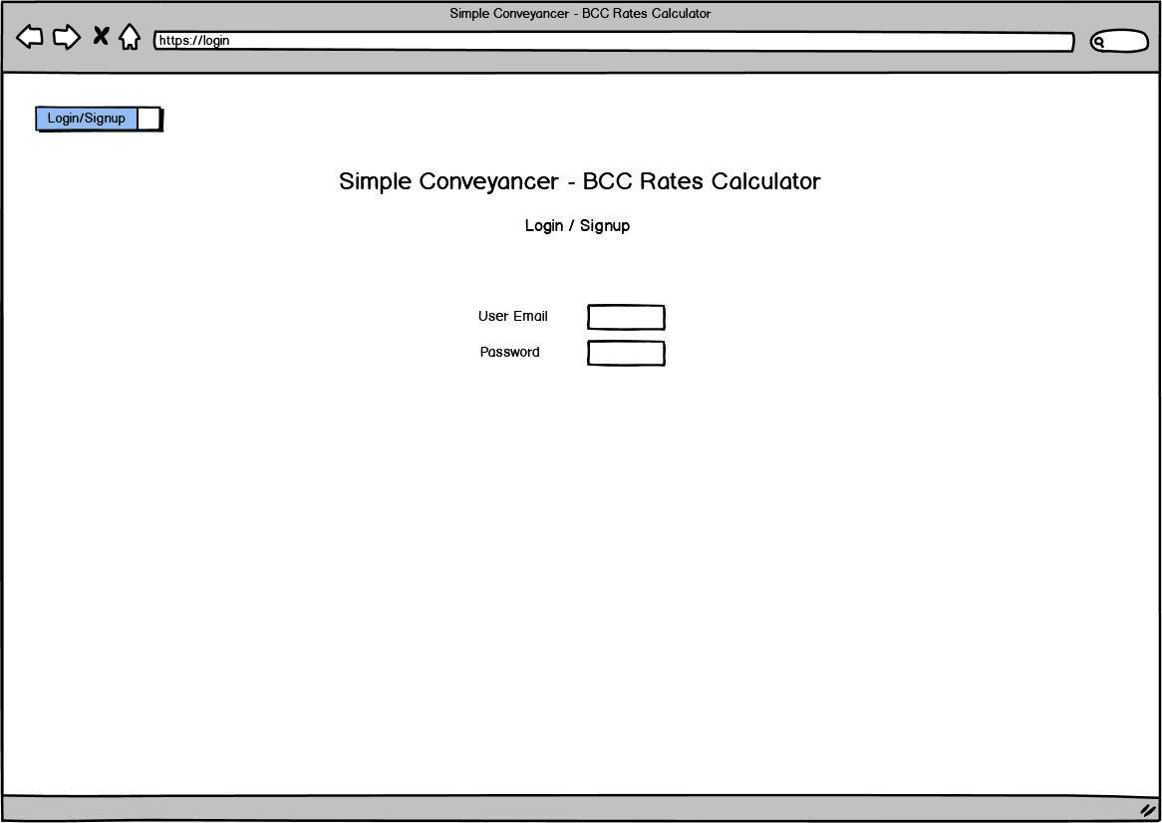
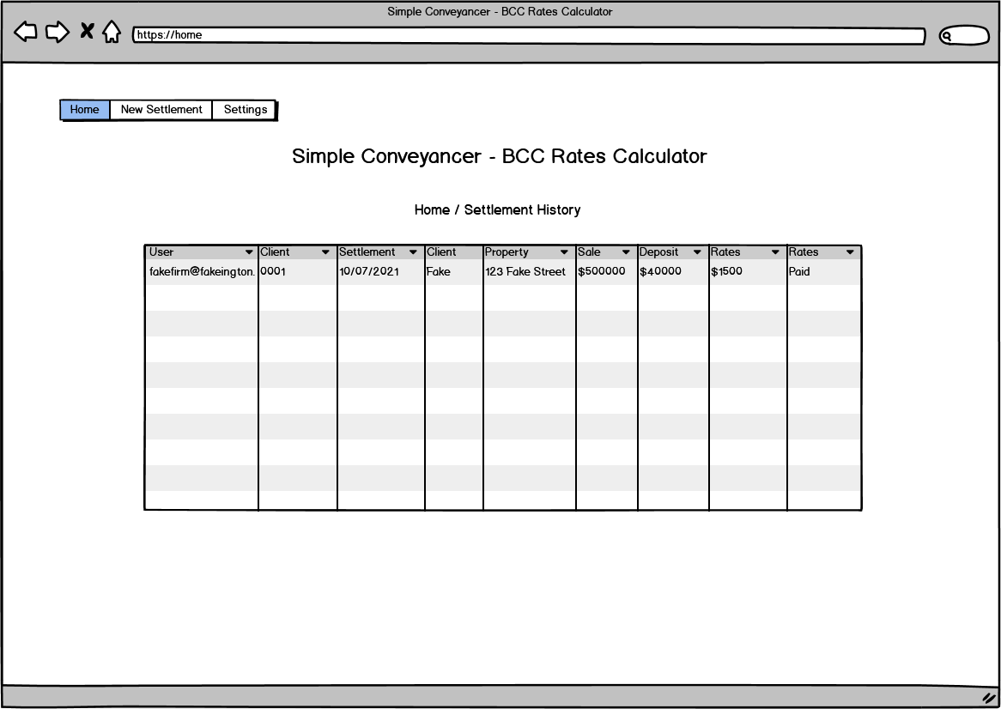
Wire Frames – Desktop 1

Slide 10
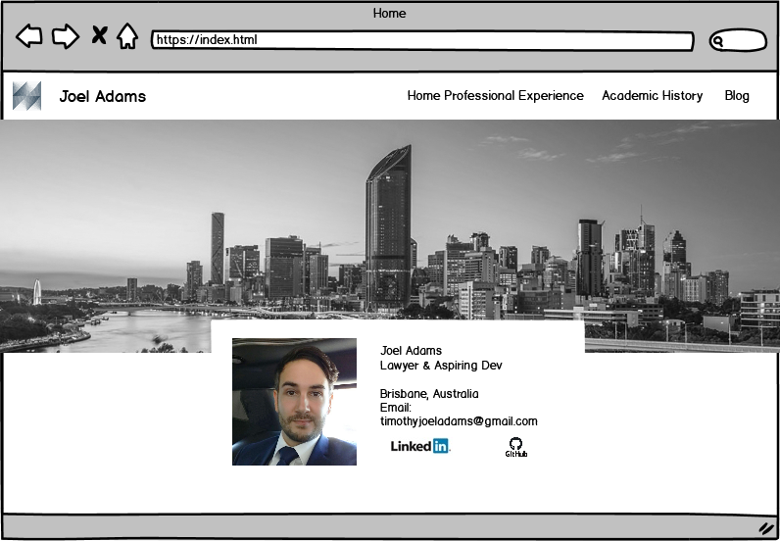
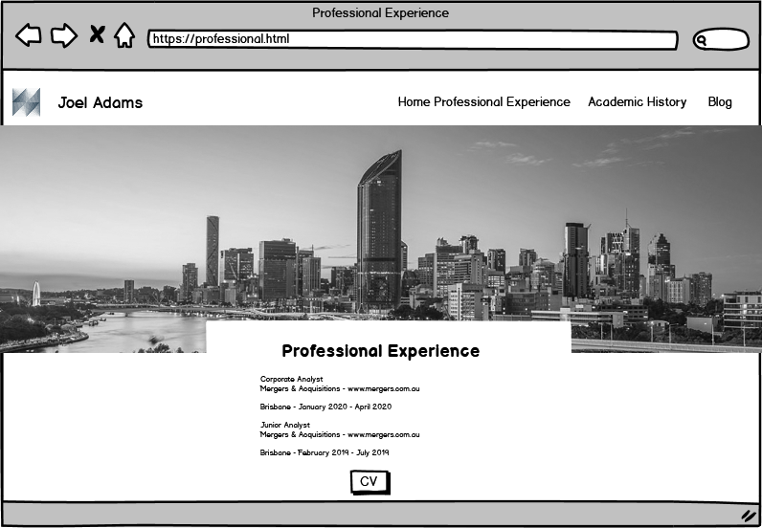
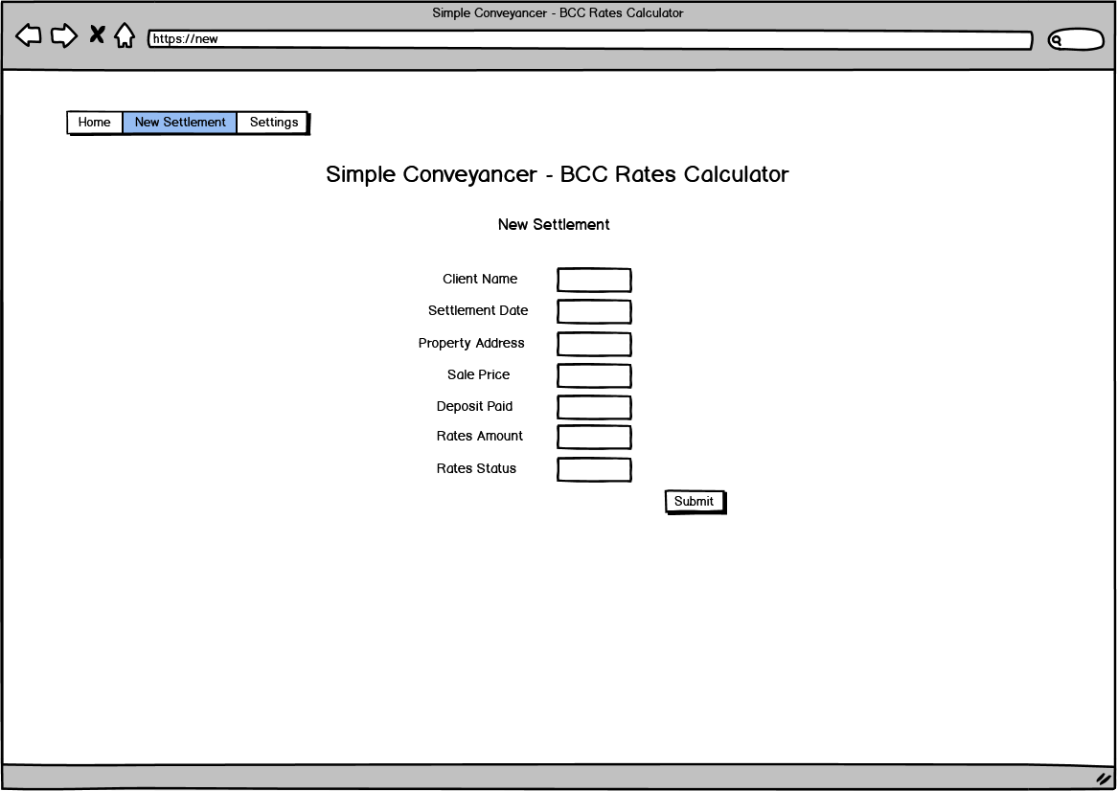
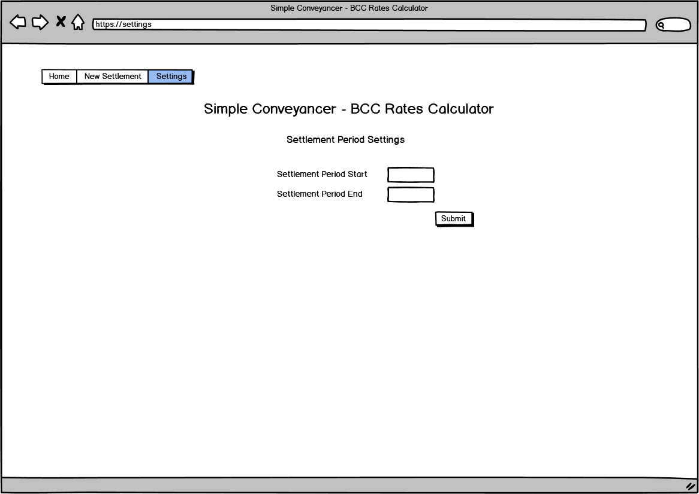
Wire Frames – Desktop 2

Slide 11
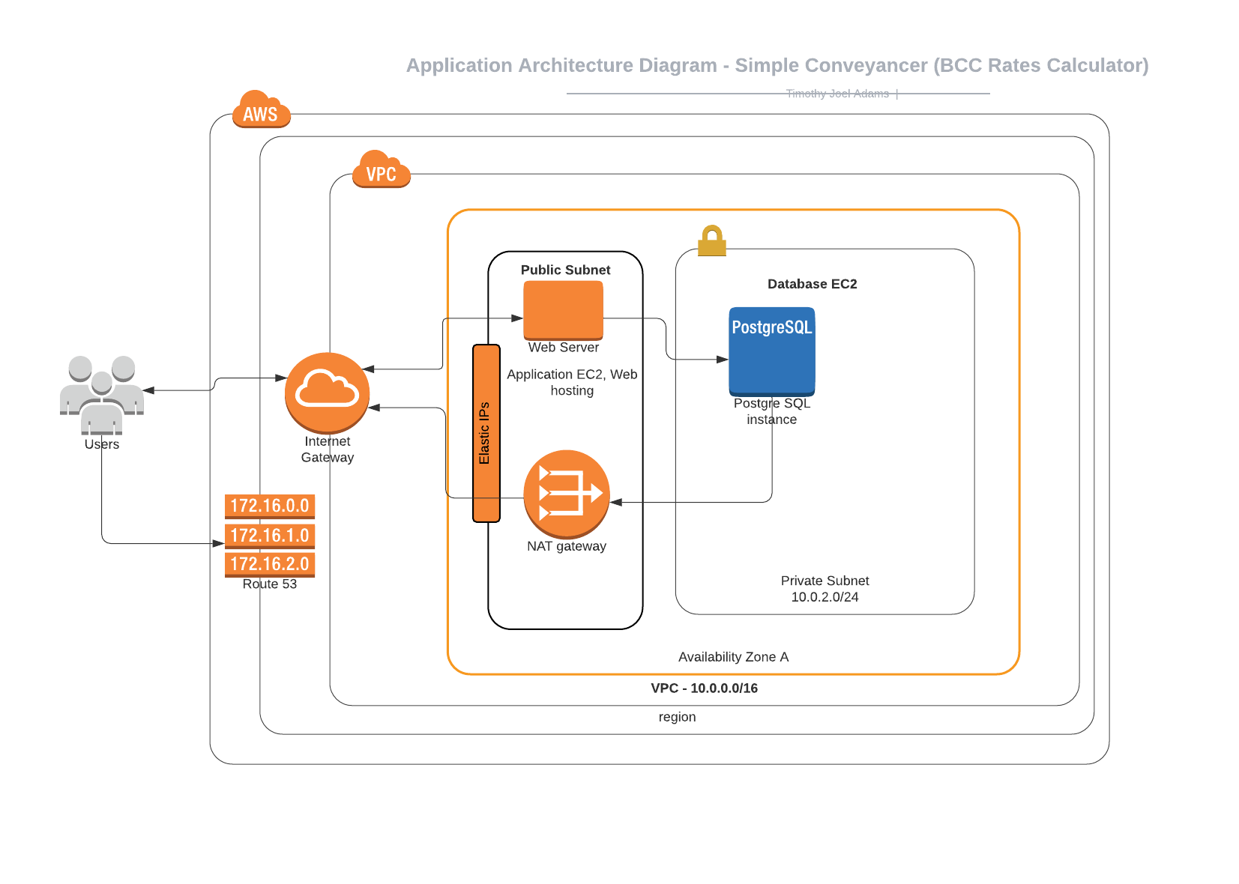
Diagrams

Slide 12
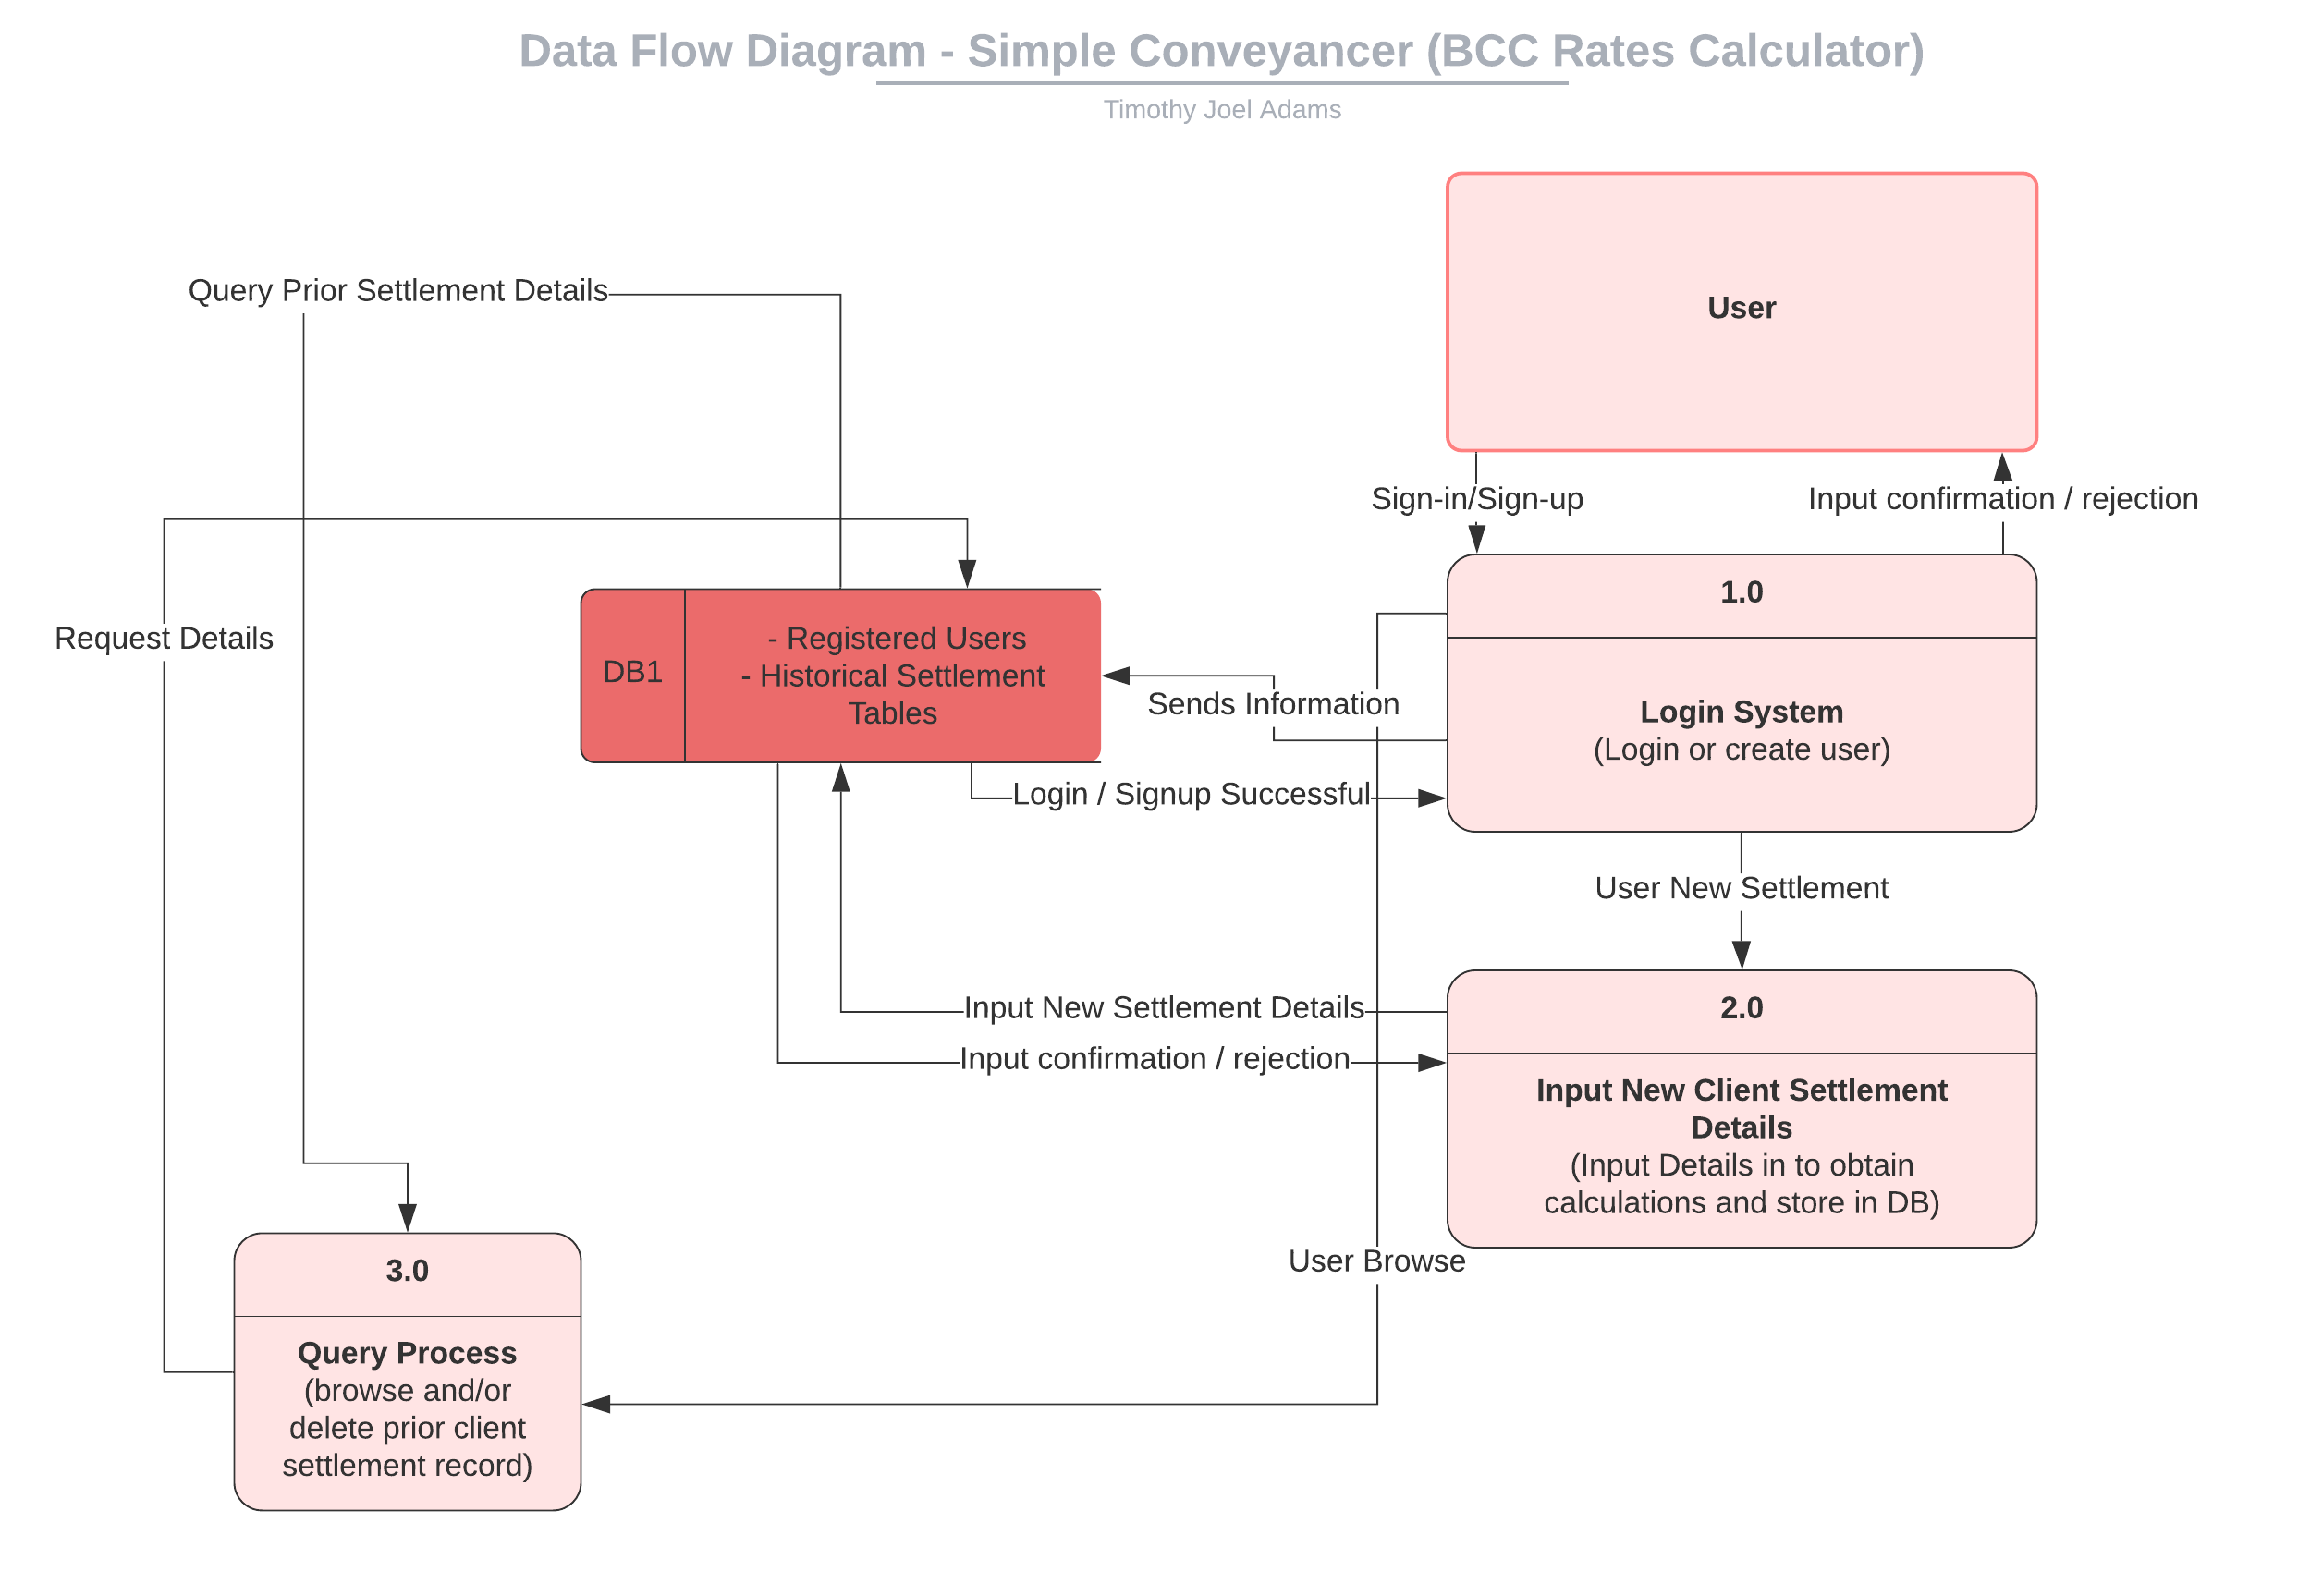
Diagrams

Slide 13
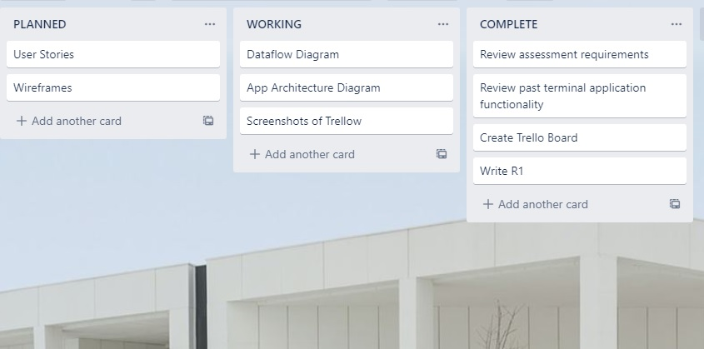
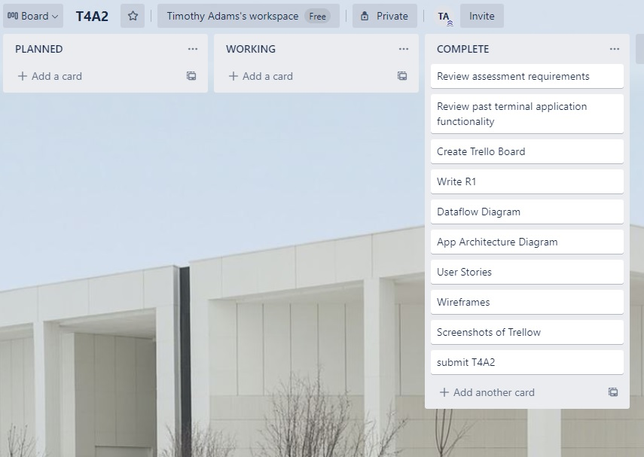
Trello

